Slide 1
LESSONS DEVELOPMENT OF A NATIONAL INTEGRATED SOCIAL PROTECTION DATA SYSTEM
ILO SOCIAL PROTECTION WORKSHOP
27 FEBRUARY 2025

Slide 2
BACKGROUND & CONTEXT
NDP2030/ MTSF: DSD Mandated to develop, implement & maintain National Integrated Social Protection Information System (NISPIS)
Challenges silo & fragmented data systems; Paper-based Monitoring & Reporting systems
Purpose: improve services to poor and vulnerable communities by integrating & sharing data; Adequate, Reliable, Real-time data
Data used for Planning; Budgeting; Decision-making; Evidence Based Policy Making
Collect data against number of indicators along the lifecycle (children, youth, adults, older person, persons with disabilities).
Developed a Concept Document/ Business Case & Costing (M&E unit; CIO; Business Units)
Consultative process; Hosted Round Table Key Stakeholders
Governance Structures (Steering Committee/ Technical Committee/ Forums (IMST))

Slide 3
PROCESSES
NISPIS MoU signed by Cluster depts (SASSA, NDA, Home Affairs, Health, DBE, DHET, NSFAS, Employment & Labour, Cooperative Governance & SITA) to share social protection data
Phased approach implement NISPIS (utilize ID/ Passport number) (Dept Home Affairs (HANIS function)
Appointed Service Provider: Conducted “AS IS” Assessment
Consultative process to develop M&E Framework included Theories of Change (Path-way of Change) and Logframes.
Enabled development of indicators for the system (technical indicator descriptors)
Piloted system Measure Educational Outcomes of Children Receiving Social Protection Services,
Reviewed the indicators (still reviewing & adding indicators)
Procured a Convergence Tool for data exchange; Live Production environment (no memory sticks etc.)
Produce various reports; Currently developing Training Plan & Communication & Awareness Plan
Change Management Framework

Slide 4
EDUCATIONAL OUTCOMES OF LEARNERS RECEIVING SOCIAL PROTECTION
NSFAS, SASSA and DBE data shared electronically
Data matched (ID#)
Data analysis and report writing
Reporting & dissemination
Educational Outcomes of Learners Receiving Social Protection Services
DSD (NISPIS)
SASSA (SOCPEN)
DBE (NSC) & (LURITS)
NSFAS
Linking various data sets using ID number, LURITS, NSC, SOCPEN to identify learners receiving/ received social grants at some point in their life and write NSC Grade 12 examination.

Slide 5
Conceptualisation
Initiation
Planning
Execution
Close-Out
Maintenance
Feasibility
Requirements
Coding
Review contracts
Review benefit realisation
Project Review
Project library
Business Case
Risk Assessment
Benefit Realisation plan
Feasibility Report
Design
Testing
Project Charter
Project Plan
Requirements Specification (URS, FRS, TRS)
Database design
Change management plan
Training
Reporting
Source code
Database
Test plan
UAT
Training manual
Proof of change management
Monitoring, Reporting & Evaluation
PROJECT MANAGEMENT FRAMEWORK
SYSTEMS DEVELOPMENT LIFE CYCLE FRAMEWORK

Slide 6
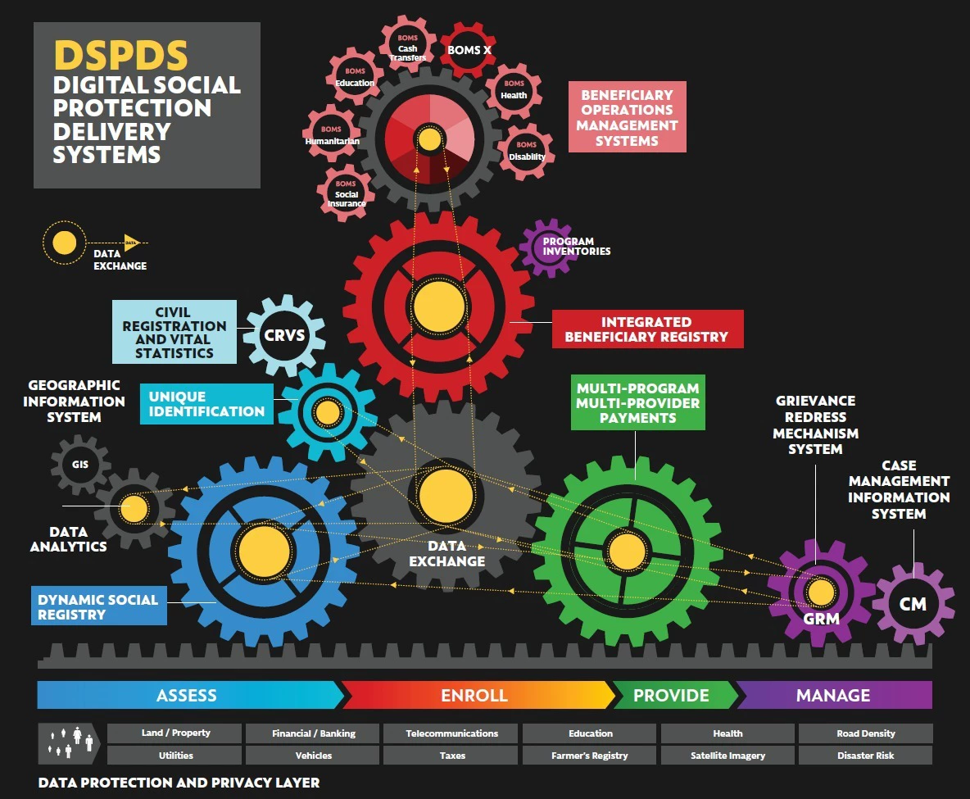
NISPIS
National
Integrated
Social
Protection
Information
System
DHET
DBE
NDA
DoH
CITIZEN SYSTEMS/ DEPARTMENT
SASSA
D0L
DSD
DHA
COGTA
Social Cluster Inventory
BIRTH REGISTRATION
PIVA
SC INTEGRATED SERVICE DELIVERY
COMPLAINTS REDRESS MECHANISM SYSTEM
CONVERGENCE
CLUSTER CASE MANAGEMENT SYSTEM
CRMS
Housing
IJS
SITA
Banking
WATER AFFAIRS
SARS
Dept of Agriculture
Correctional Services
NATIONAL TREASURY

Slide 7
Thank you

